Slide 1
CAPSTONE PROJECT SENTIMENT ANALYSIS
Presented by:
1.Manukonda.Chandrika-Vignan’s Nirula Institute of Technology and Science for Women-CSD

Slide 2
OUTLINE
Problem Statement
Proposed System/Solution
System Development Approach
Algorithm & Deployment
Result
Conclusion
Future Scope
References

Slide 3
PROBLEM STATEMENT
Example: currently the hotel industry , specifically focusing on the five-star hostels. Explain the significance of customer reviews and hope they impact a hotel’s reputation and business. To understand the sentiment behind customer reviews to improve their services we use sentiment analysis. Here we mainly aim to identify positive and negative aspects mentioned by customers.
Develop a sentimental analysis model to classify Reviews as positive or negative .
Preprocess the review.
Preprocess the review text using techniques such as lower casing ,removing stop words and Lematization.
Use the trained model accurately predict the sentiment of new,unseen reviews.

Slide 4
PROPOSED SOLUTION
The proposed system aims to address of predicting the required review count each week to ensure satisfaction from the customers. This involves machine learning techniques and Naïve Bayes algorithm to forecast accuracy rate. The solution will consist of following components:
Data collection:
Gather historical data on customer reviews, including service quality, cleanliness and other relevant factors.
Utilize real time data sources, such as guest feedback and review platforms, staff performance and etc.
Data preprocessing:
Clean and process the collected data to handle removing numbers & stop words, lemmatization etc.

Slide 5
PROPOSED SOLUTION
Machine learning Algorithm:
Implement a machine learning algorithm, such as feature extraction, count vectorizer and TfIdf vectorizer etc.
Deployment:
Develop a user friendly interface or application that provides real time predictions for review count at different weeks.
Deploy a solution on a scalable and reliable platform ,considering like response time, server infrastructure and user accessibility.
Evaluation: Metrics classification is used to find the accuracy rate on reviews.
Result: Finally we get the accuracy rate and predict the review is either positive or negative from unseen reviews.

Slide 6
SYSTEM APPROACH
The “system approach” section outlines the overall strategy and methodology for developing and implementing the prediction on reviews. Here’s a suggested structure for this section:
System requirements such as historical data and etc.
Library required to build the model we require seven processors such as NLDK processor, matplotlib , seaborn, sklearn , beautiful soup libraries and etc.

Slide 7
ALGORITHM & DEPLOYMENT
In the algorithm section, describe the machine learning algorithm chosen for predicting reviews count. Here’s an example structure for this section:
Algorithm Section: Choose appropriate sentiment analysis technique such as Naïve Bayes for Text Classification, probabilistic approach, feature representation and fast prediction etc.
Data Input: For sentiment analysis, the input involves gathering customer reviews and feedback from various sources enabling them to identify areas of improvement and enhance overall service quality effectively.
Training process: preprocessing reviews by cleaning, tokenizing and normalizing text data extracted from hotel websites, google reviews and social media channels.
Prediction process: Apply trained sentiment analysis models to predict sentiment labels( positive, negative)

Slide 8
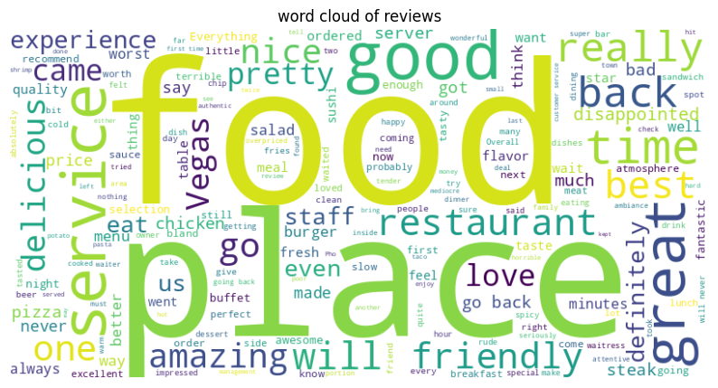
RESULT
plt.figure(figsize=(10,6))
plt.imshow(wordcloud,interpolation="bilinear")
plt.axis('off')
plt.title('word cloud of reviews')
plt.show()

Slide 9
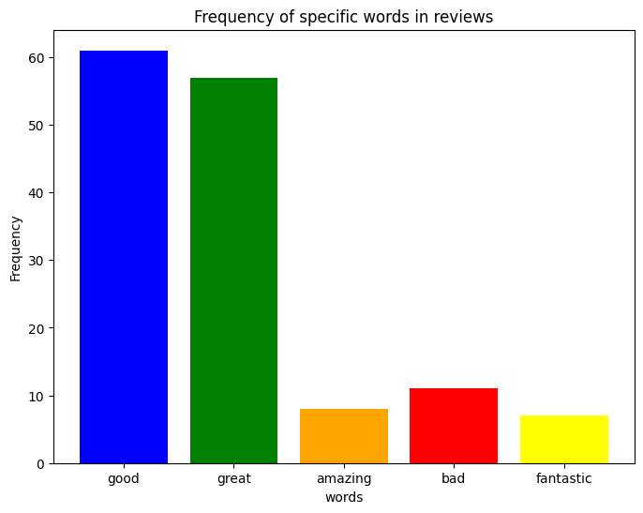
RESULT
Accuracy:0.8 classification Report: precision recall f1-score support 0 0.76 0.85 0.80 96 1 0.85 0.75 0.80 104 accuracy 0.80 200 macro avg 0.80 0.80 0.80 200 weighted avg 0.81 0.80 0.80 200
The unseen review prediction as follows:
Review:'This resturant food is good’
Predict sentiment:Positive

Slide 10
CONCLUSION
Analyzing sentiments through advanced sentiment analysis techniques offers crucial insights into hotel service quality and customer satisfaction. By systematically examining positive sentiments, hotel service providers can identify and reinforce areas of excellence, such as compassionate care and effective service outcomes. Conversely, negative sentiments pinpoint specific challenges like communication gaps and other. These findings empower organizations to implement targeted improvements and enhancing overall service delivery and customer experience.
In conclusion, sentiment analysis serves as a powerful tool for driving continuous improvement in hotel services. By translating customer feedback into actionable insights and strategic initiatives, hotel service providers can optimize negative reviews regarding certain issues and reinforces the commitment to delivering high-quality hotel service experiences that meet and exceed customer expectations.

Slide 11
FUTURE SCOPE
Enhanced Personalization: Utilize sentiment analysis to personalize customer interactions and hotel service plans based on individual preferences and feedback.
Real-Time Feedback Mechanisms: Implement real-time feedback systems to capture and analyze customer experiences in real-time ,enhancing online food delivery.
Predictive Analytics: Develop predictive model using historical sentiment data to anticipate customer needs .
Cross-Institutional Benchmarking: Establish benchmarks for sentiment analysis across hotel managment institutions to compare performance and identify best practices for continuous improvement.

Slide 12
THANK YOU

